Slide 1

Password Strength
Game
Foo Fang Woei

Slide 2

Project Vision & Background
Project Vision & Background
Educate users about strong password practices.
Provide an interactive learning game.
Three levels of difficulty to teach password creation.
Encourage awareness of cybersecurity through practice.

Slide 3





Project Plan & Sprints
Sprint 1: Requirements & Research
Studied password guidelines and game concept.
Sprint 2: System Design
UML Use Case completed.Game flow planning.
Project Plan & Sprints
Sprint 3: Initial Prototype
Basic UI, level selection, input validation.
Sprint 4: Testing & Refinement
Adjust rules, test user flow.

Slide 4
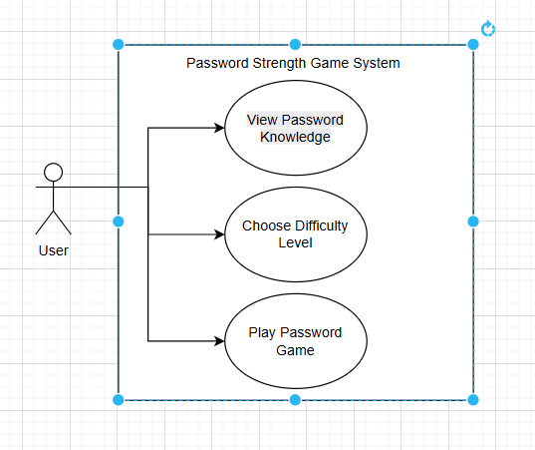
UML Models
Shows: View Knowledge, Choose Level, Play Game.
Levels Easy, Medium, Hard extend main game use case.

Slide 5

Challenges Faced
Setting clear password strength levels
Choosing between API or built-in code
We must decide what rules make a password “Easy”, “Medium”, or “Hard”.
We need to decide whether to use a password-strength API or write our own checking rules in the code.

Slide 6
Prototype

Slide 7
THANKS

